Slide 1

Practical Course: XML Technology
BlackJack in XML
Supervisor: Prof. Dr. Anne Brüggemann-Klein
Developers: Robert Urban, Anne-Catherine Seeser, Lennert Rienau,
Michael Mitterer, Manuel Ehler
Garching, 08/30/2017

Slide 2
Agenda
Introduction
Technologies
Design and Implementation
Architecture
Testing
Development
Conclusion
Demo

Slide 3
1. Introduction
Team
Team work
Project’s context & Requirements
Introduction
Technologies
Design
Architecture
Testing
Development
Conclusion
Demo

Slide 4



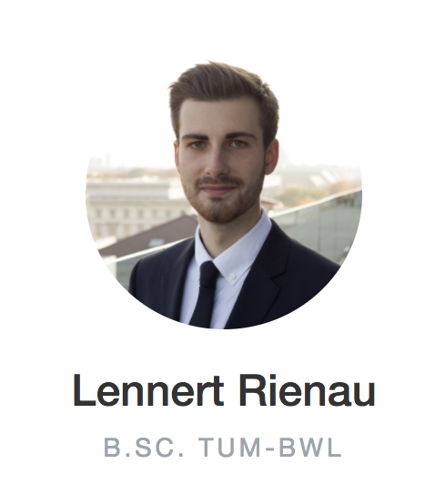
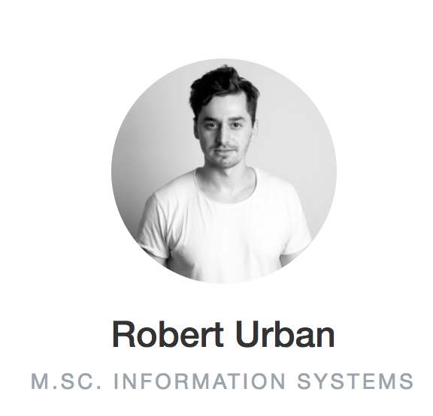
1. Introduction - Team
Introduction
Technologies
Design
Architecture
Testing
Development
Conclusion
Demo

Slide 5
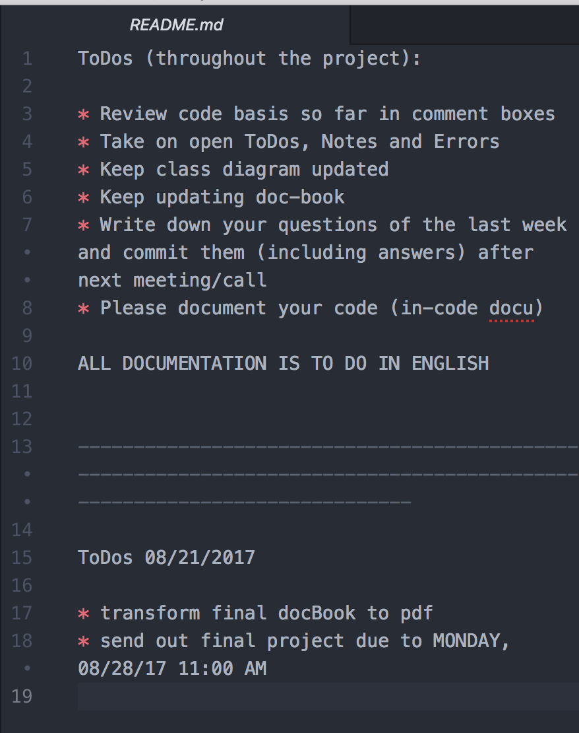
1. Introduction – Team work
Weekly team meetings
On-sight in Garching
Distributed: skype progress meetings
ToDos marked in holistic Readme file
ToDos marked in source code
Presentation and question rounds for each team member
Git version control with progress steps in commit messages
Introduction
Technologies
Design
Architecture
Testing
Development
Conclusion
Demo

Slide 6

1. Introduction - Requirements
BlackJack Game as Web Application with XML Stack
GUI with SVG and XSLT transformation
URL mapping with RestXQ
Several Games controlled by server logic and BaseX database
UML Classdiagram
DocBook documentation with design implications and reflection
Introduction
Technologies
Design
Architecture
Testing
Development
Conclusion
Demo

Slide 7
2. Technologies
DocBook
XML
Xquery
SVG
XSLT
XHTML
Introduction
Technologies
Design
Architecture
Testing
Development
Conclusion
Demo

Slide 8
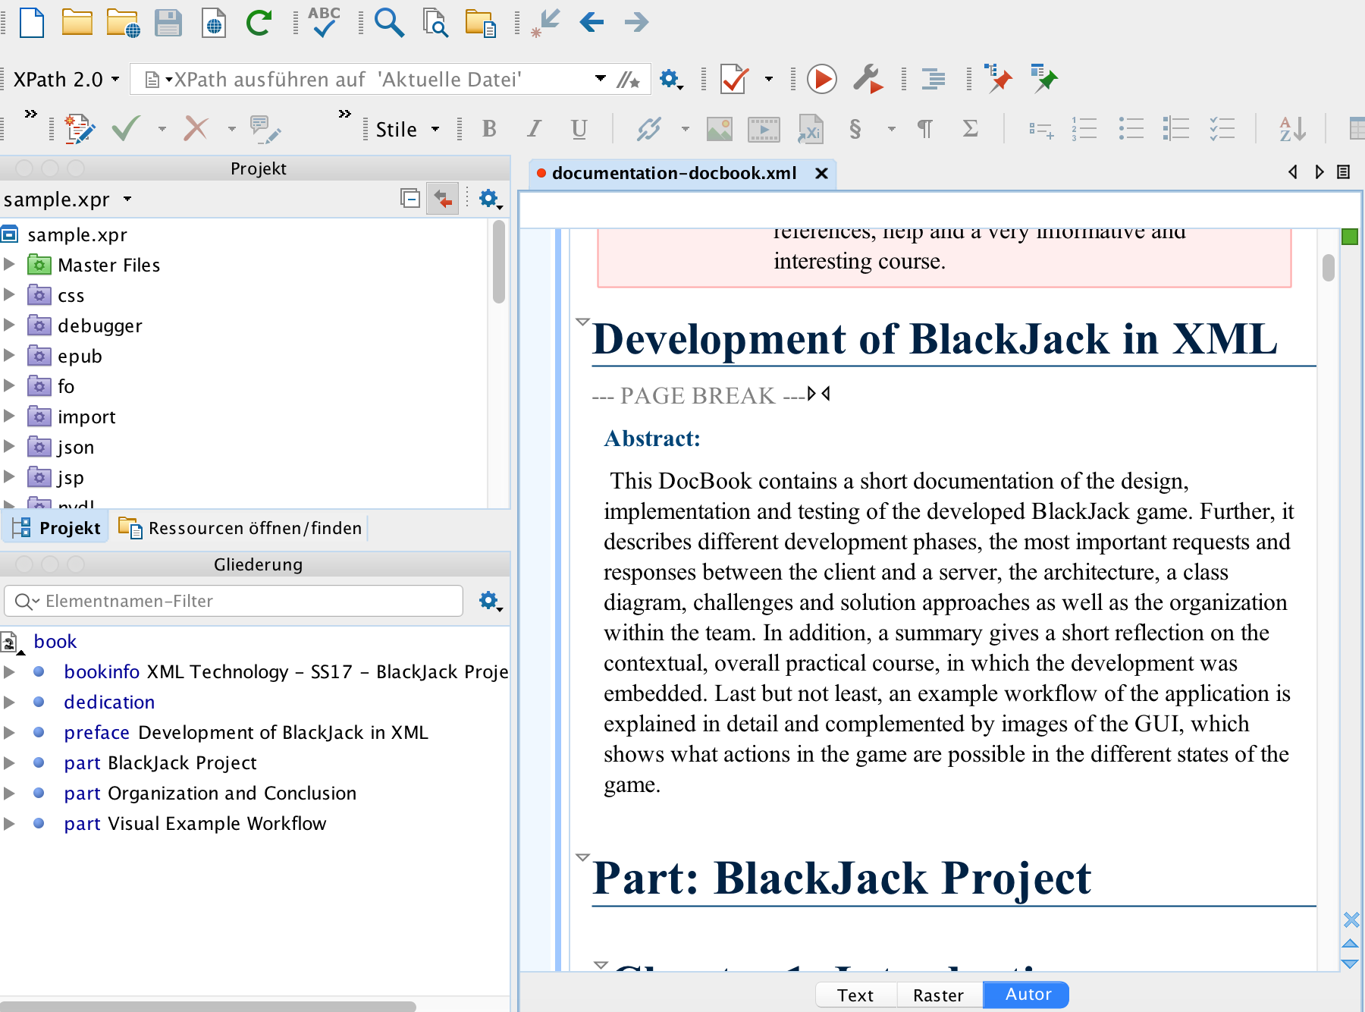
2. Technologies - DocBook
Project documentation
with DocBook
Introduction
Technologies
Design
Architecture
Testing
Development
Conclusion
Demo

Slide 9
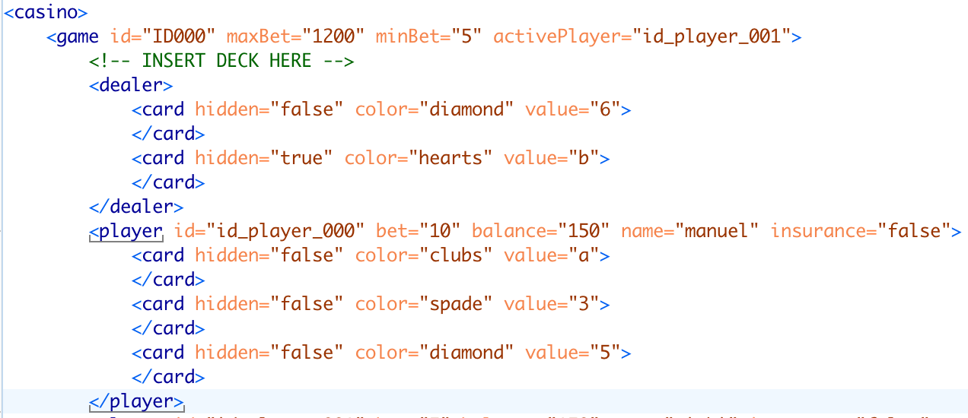
2. Technologies - XML
Markup language, which defines a set of encoding rules for digital documents
Introduction
Technologies
Design
Architecture
Testing
Development
Conclusion
Demo

Slide 10
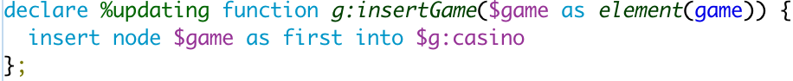
2. Technologies - XQuery
For finding and
extracting data
from large XML
documents
Introduction
Technologies
Design
Architecture
Testing
Development
Conclusion
Demo

Slide 11
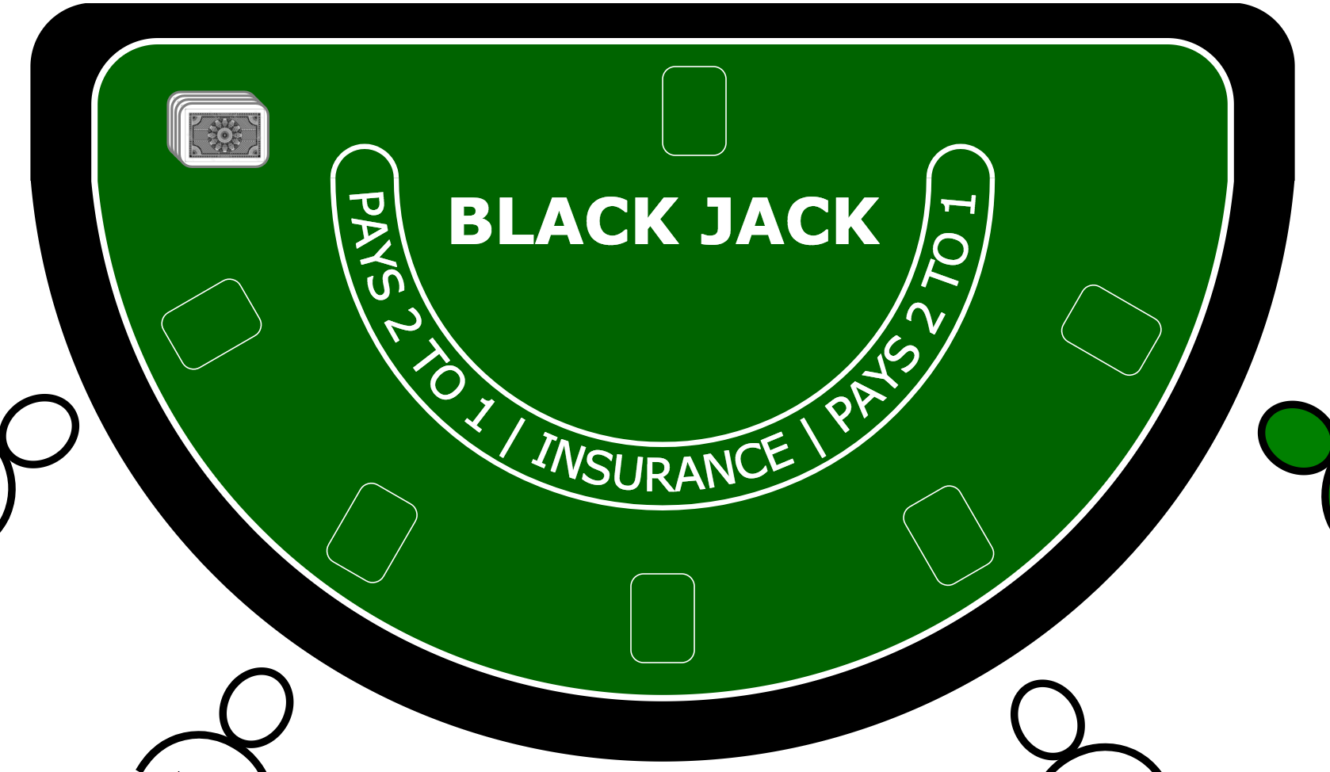
2. Technologies - SVG
Enables vector based
graphics
Introduction
Technologies
Design
Architecture
Testing
Development
Conclusion
Demo

Slide 12
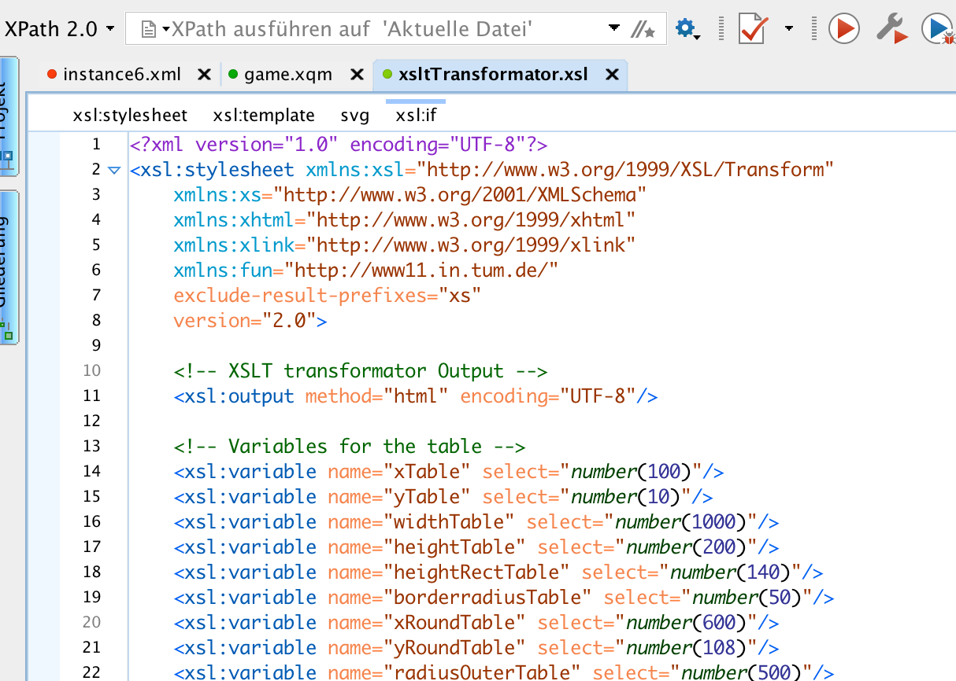
2. Technologies - XSLT
for transforming XML documents into other XML documents, or other formats such as HTML for web pages
Introduction
Technologies
Design
Architecture
Testing
Development
Conclusion
Demo

Slide 13
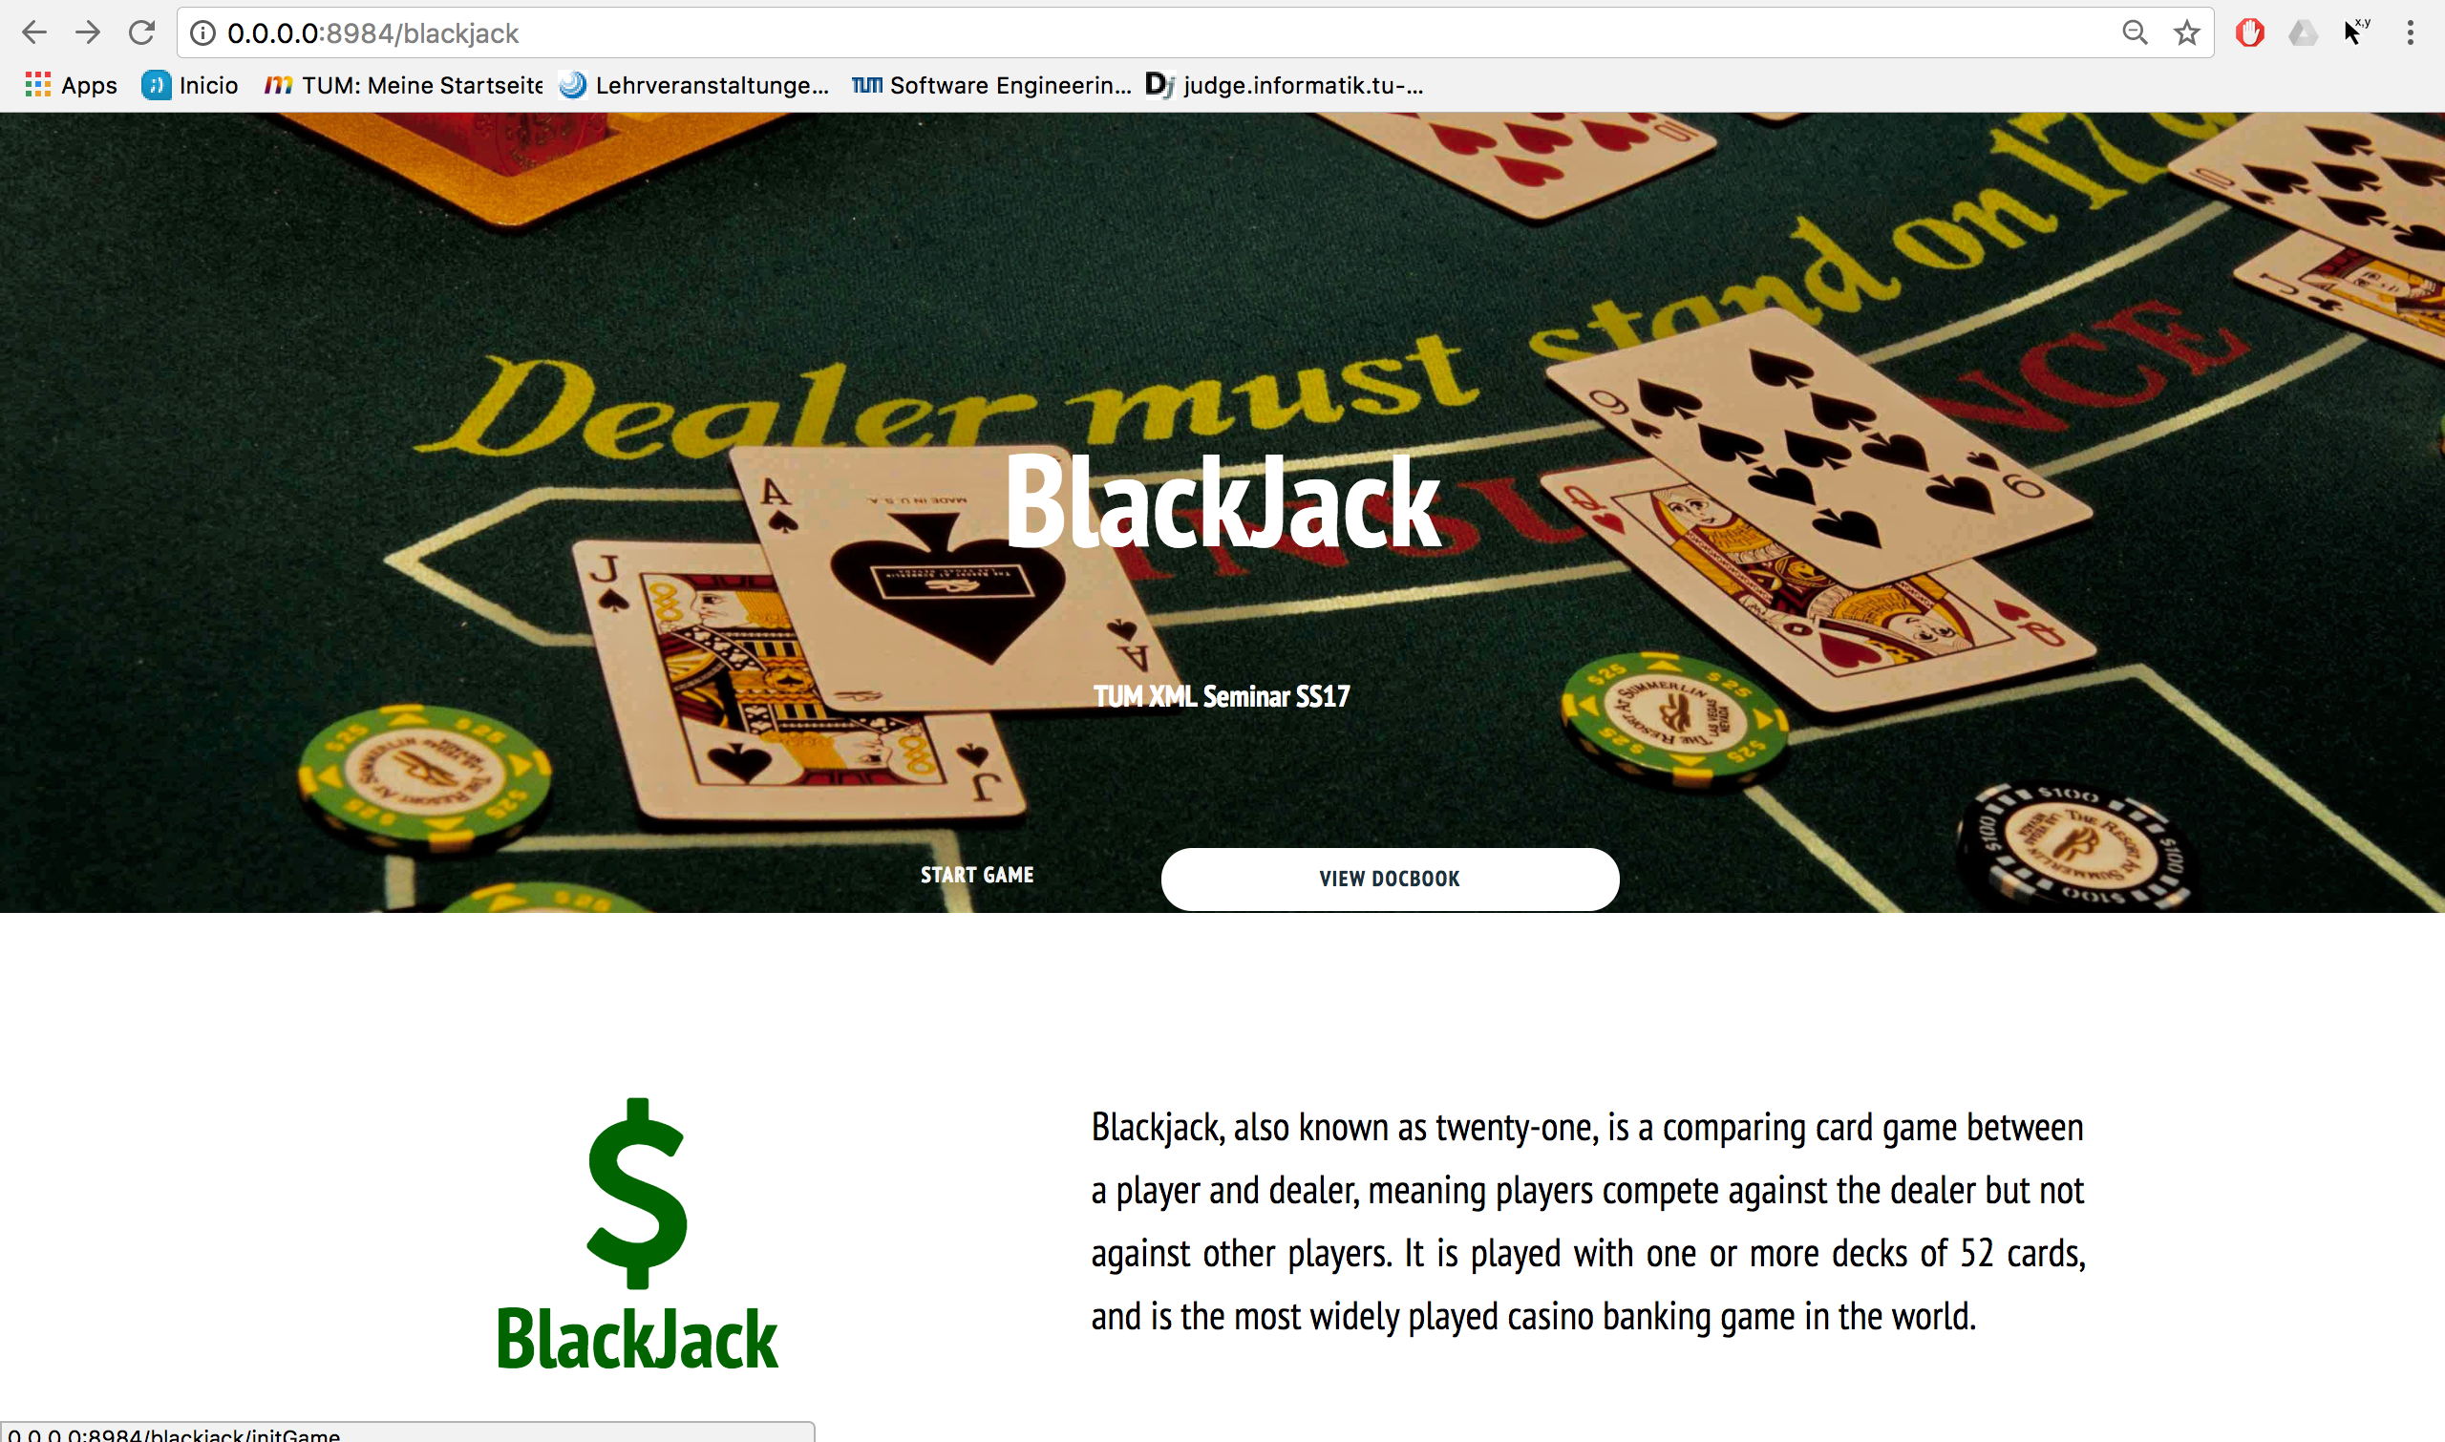
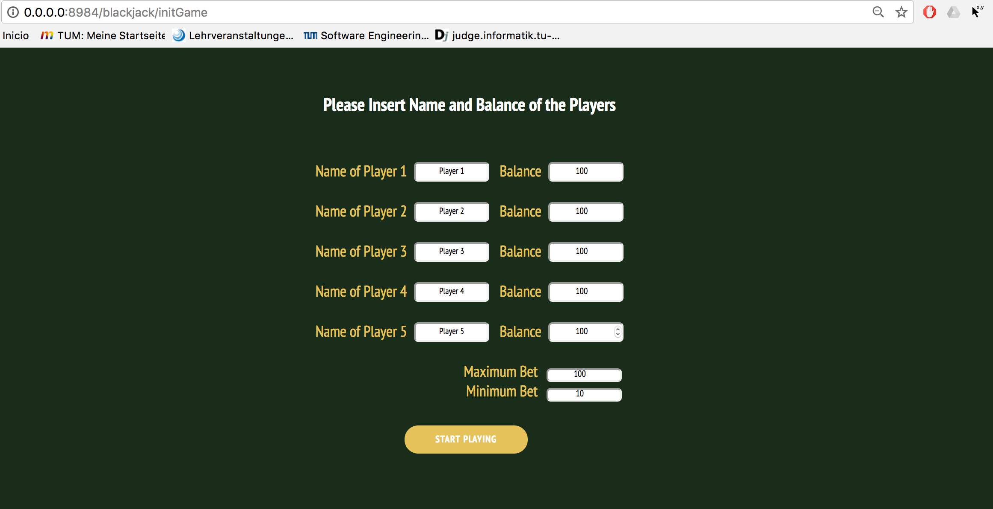
2. Technologies - XHTML
Defines structure of web
pages
Introduction
Technologies
Design
Architecture
Testing
Development
Conclusion
Demo

Slide 14
3. Design and Implementation
Rules
Number of players
Card deck
Drawing cards
Player actions
Bet
Insurance
Hit
Stand
Winnings status and winnings
Dealer wins against player
Player wins against dealer
Tie between player and dealer
→ Realistic casino experience!
Introduction
Technologies
Design
Architecture
Testing
Development
Conclusion
Demo

Slide 15
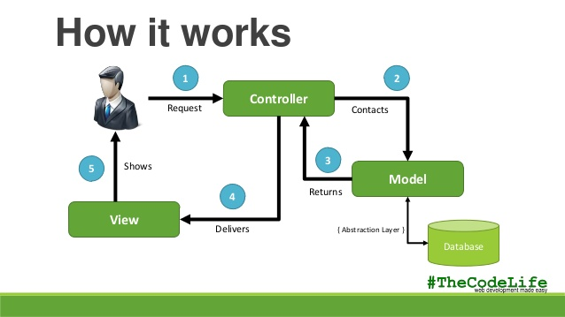
4. Architecture – MVC
Source: https://image.slidesharecdn.com/modelviewcontrollermvc-140211001124-phpapp01/ 95/model-view-controller-mvc-6-638.jpg?cb=1392077579, accessed on 08/23/17 at around 04:19 PM
Introduction
Technologies
Design
Architecture
Testing
Development
Conclusion
Demo

Slide 16
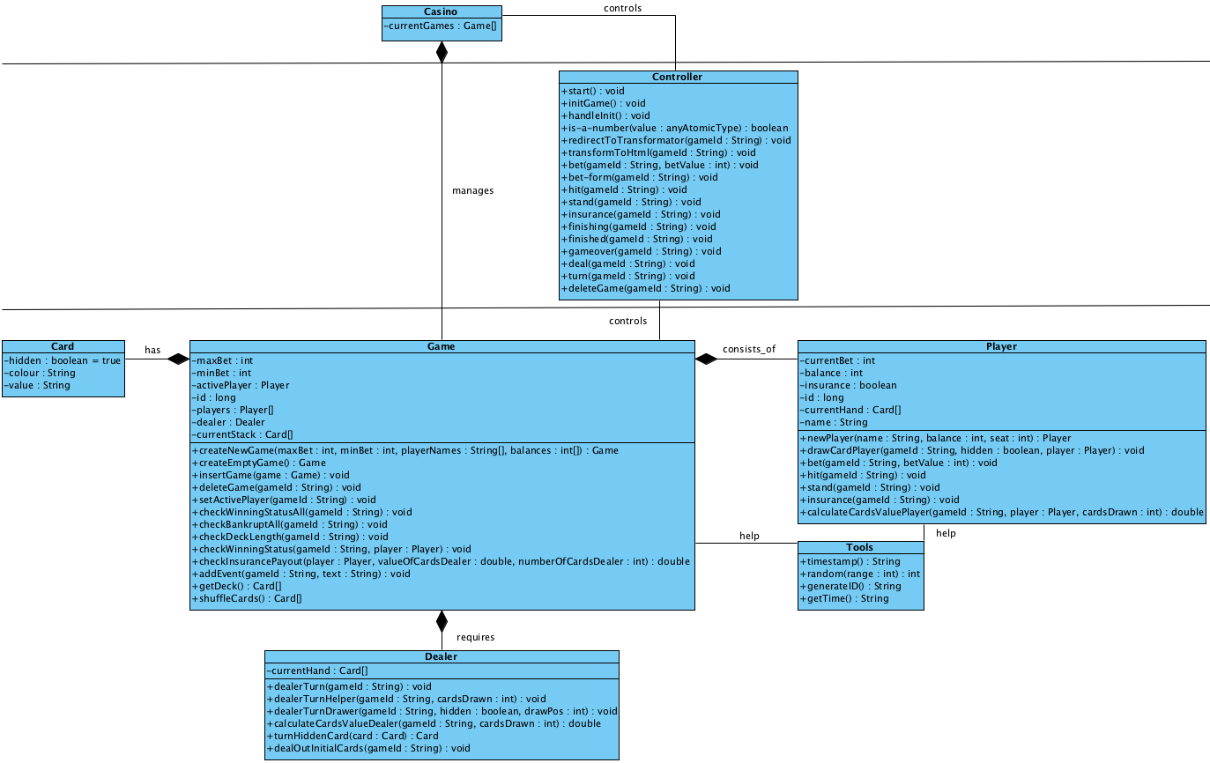
4. Architecture – Class Diagram
Introduction
Technologies
Design
Architecture
Testing
Development
Conclusion
Demo

Slide 17
5. Testing
Reviews
Unit tests
Integration tests
REST queries with additional functions
Borderline cases
Introduction
Technologies
Design
Architecture
Testing
Development
Conclusion
Demo

Slide 18
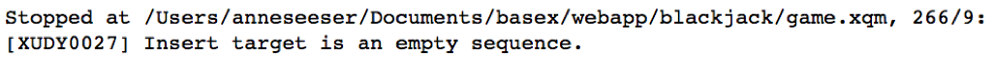
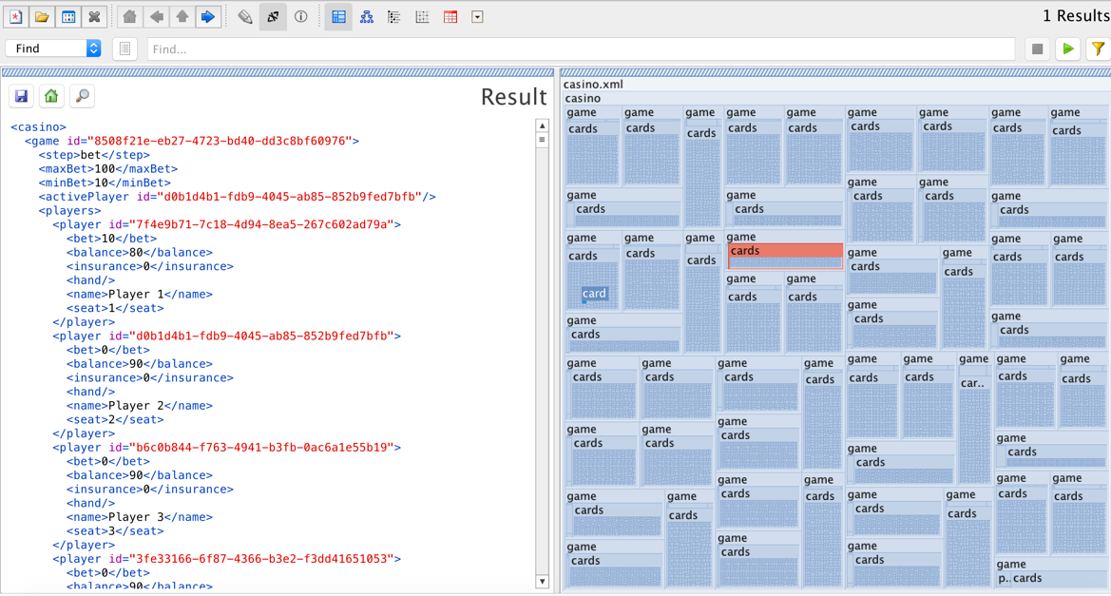
5. Testing - Unit Test
individual units of source code are tested, to determine whether they are fit for use.
Introduction
Technologies
Design
Architecture
Testing
Development
Conclusion
Demo

Slide 19
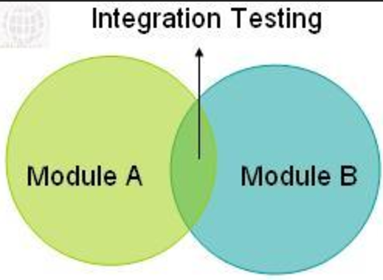
5. Testing - Integration Test
individual software modules are combined and tested as a group
Introduction
Technologies
Design
Architecture
Testing
Development
Conclusion
Demo

Slide 20
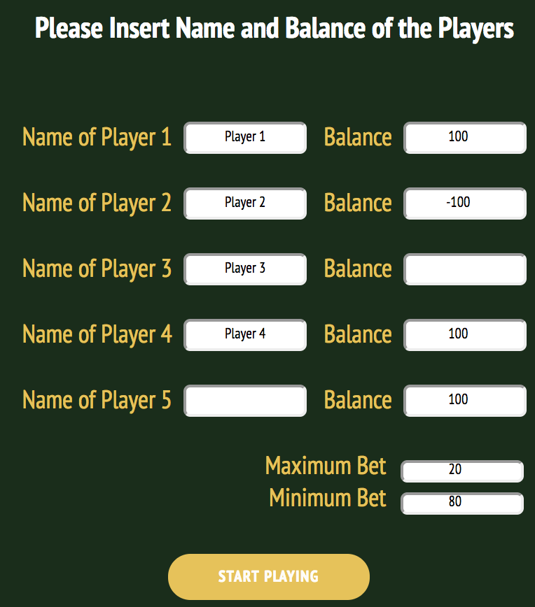
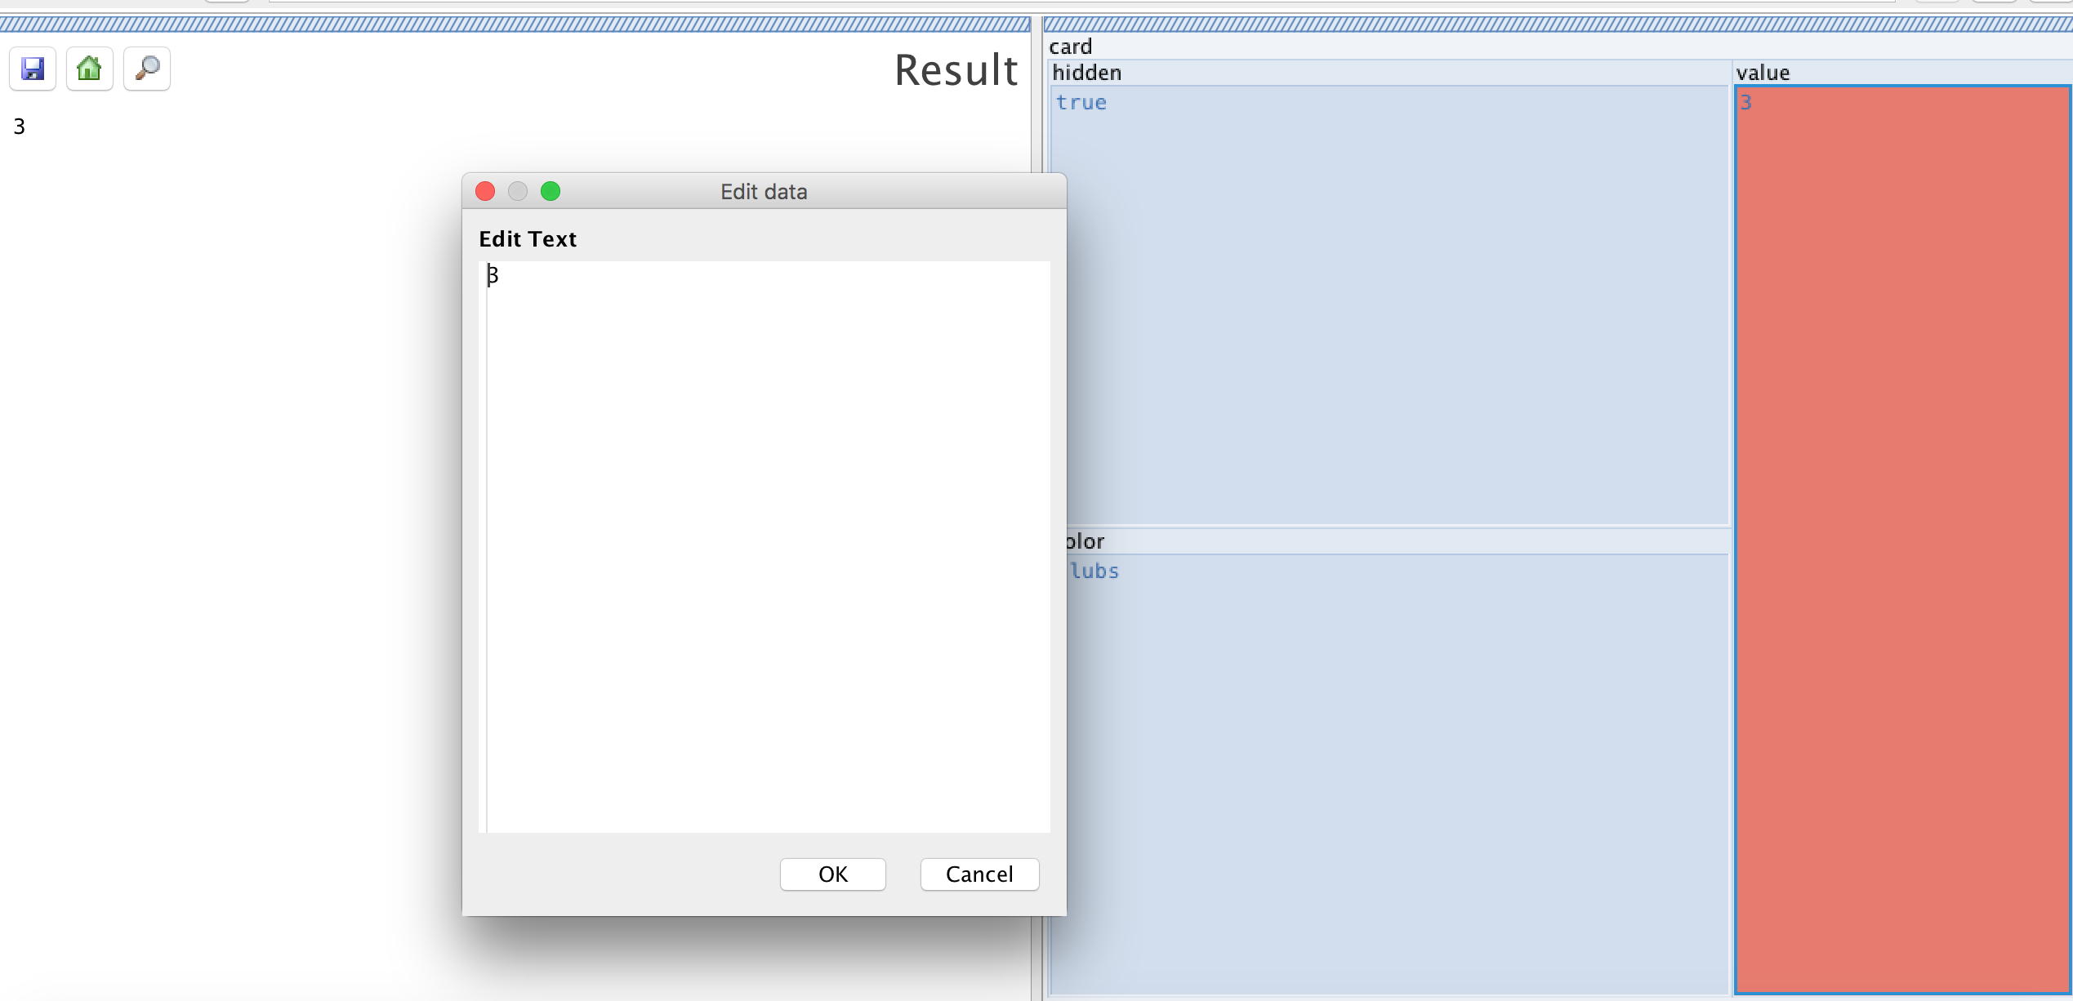
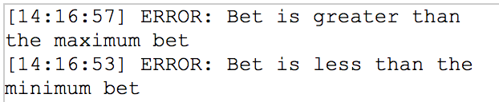
5. Testing - Borderline Cases
Introduction
Technologies
Design
Architecture
Testing
Development
Conclusion
Demo

Slide 21

5. Testing - Reviews
Double and triple check the written
code of each others by reviews
→ High implementation quality
Introduction
Technologies
Design
Architecture
Testing
Development
Conclusion
Demo

Slide 22



6. Development – Environment
Sources: https://www.oxygenxml.com/img/mb_xml_editor.png , accessed on 08/28/17 at around 05:55 PM
http://basexgmbh.de/wp-content/uploads/2013/04/BaseX-300x252.png , accessed on 08/28/17 at around 06:00 PM
https://www.aha.io/assets/github.7433692cabbfa132f34adb034e7909fa.png , accessed on 08/28/17 at around 06:00 PM
Introduction
Technologies
Design
Architecture
Testing
Development
Conclusion
Demo
Notes:
Tools und Methoden:
Oxygen, BaseX -> Gemeinsame Plattform -> Helfen
GitHub -> Gleichzeitiges Arbeiten, Übersicht über Änderungen, Versionsmanagement

Slide 23
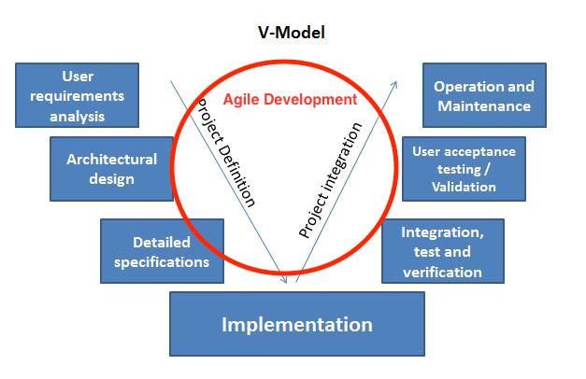
6. Development – Phases
V-Model
Integrated agile development
Source: https://sinergique.files.wordpress.com/2013/10/v-model-illustration.jpg, accessed on 08/24/17 at around 04:20 PM
Introduction
Technologies
Design
Architecture
Testing
Development
Conclusion
Demo
Notes:
Groß: V-Modell -> Requirements, Klassendiagramm
Implementierung, Testen -> Agil: wöchtenl. Treffen (Review, Code-Diskussion, ToDo-Liste)
„Sprints“:

Slide 24

7. Conclusion
Source: http://clipartix.com/wp-content/uploads/2016/04/Thumbs-up-clipart-cliparts-for-you.jpg, accessed on 08/24/17 at around 04:33 PM
Introduction
Technologies
Design
Architecture
Testing
Development
Conclusion
Demo

Slide 25

Reflection
Initial decisions and discussion of rules, game logic and flow was very important
Weekly:
Understanding code and asking questions lead to walkthroughs
Coordination across different time zones
Learning from each team member (code and work ethics)
Introduction
Technologies
Design
Architecture
Testing
Development
Conclusion
Demo

Slide 26
Challenges & Outlook
Challenges
Understanding the basic concept of XML web stack
BaseX, RestXQ and http server functionality
Improve GUI for good game flow
Outlook
Add special effects to GUI
Play on several machines
Introduction
Technologies
Design
Architecture
Testing
Development
Conclusion
Demo

Slide 27
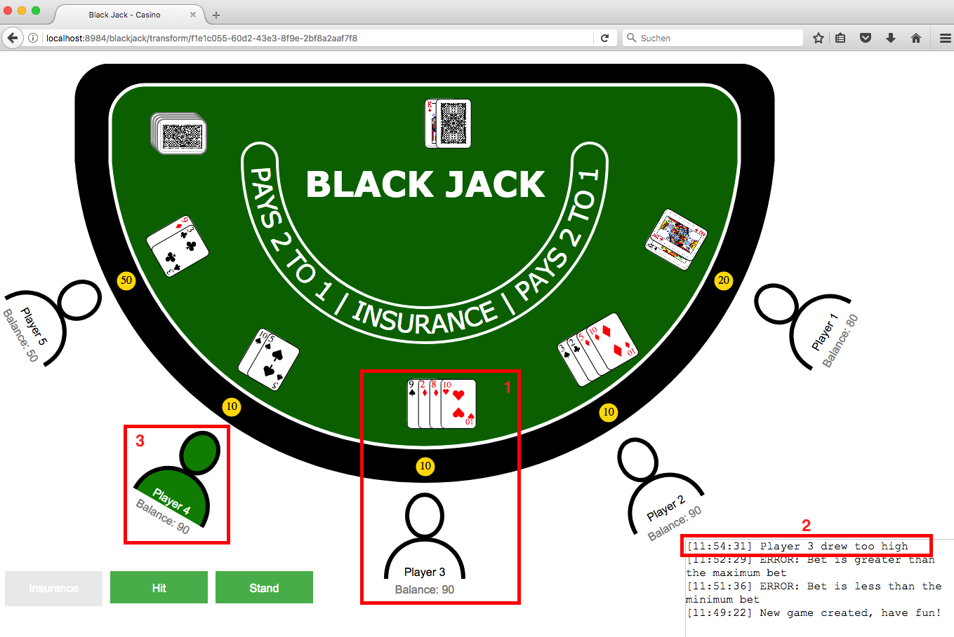
8. Demo – Overview GUI
Introduction
Technologies
Design
Architecture
Testing
Development
Conclusion
Demo

Slide 28
8. Demo – Live
Live-Demo
Introduction
Technologies
Design
Architecture
Testing
Development
Conclusion
Demo

Slide 29
Thank you very much!

Slide 30
Practical Course: XML Technology
Developers: Robert Urban, Anne-Catherine Seeser, Lennert Rienau,
Michael Mitterer, Manuel Ehler
Garching, 08/30/2017

Slide 31
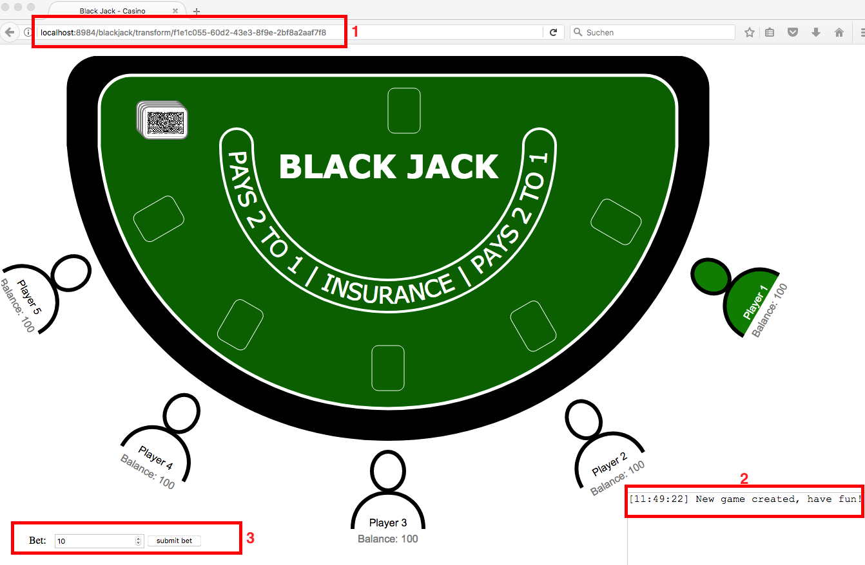
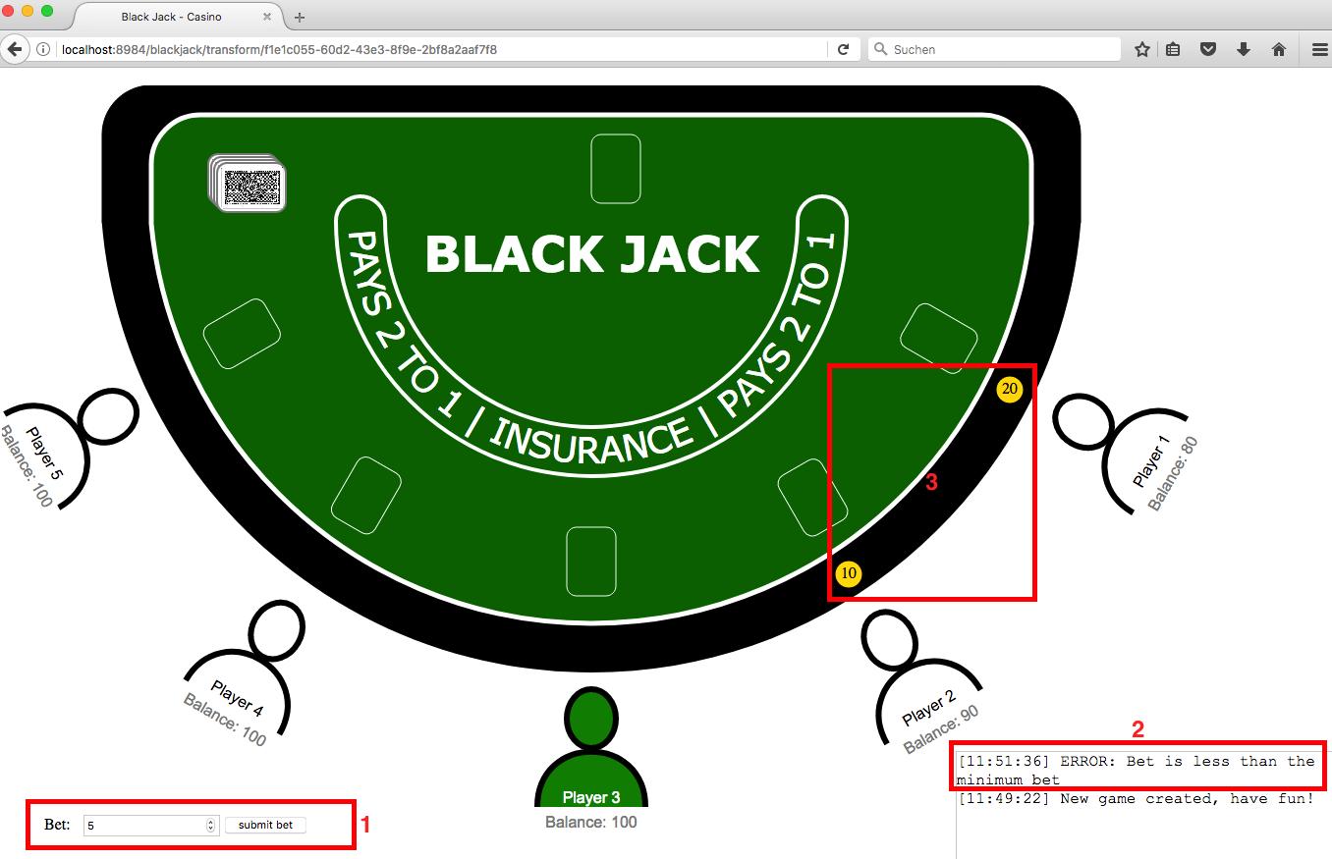
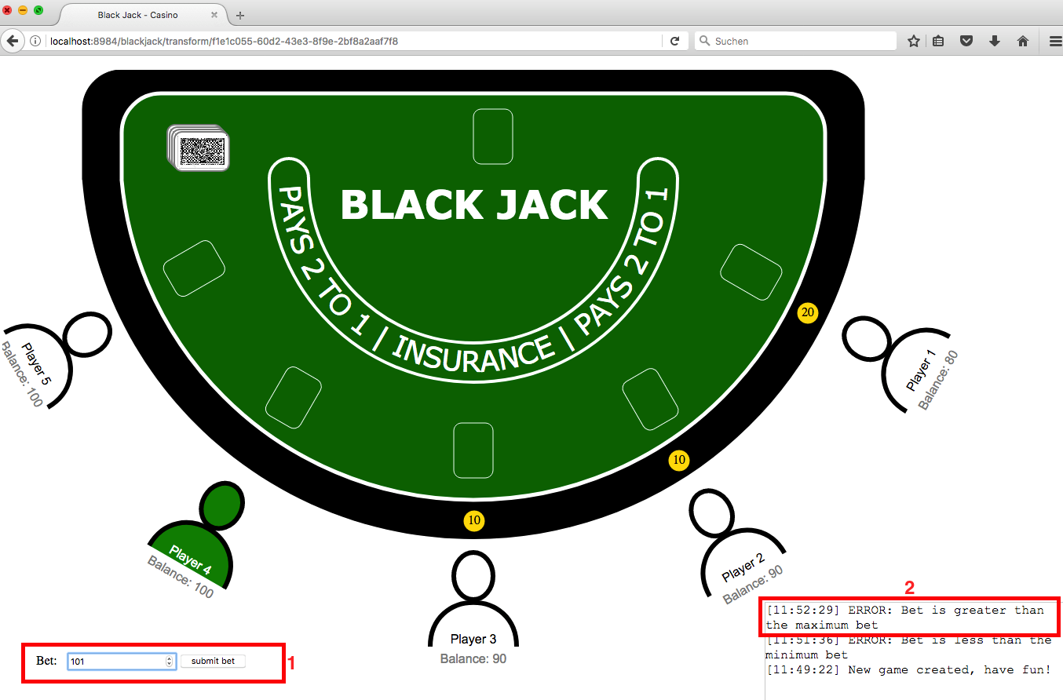
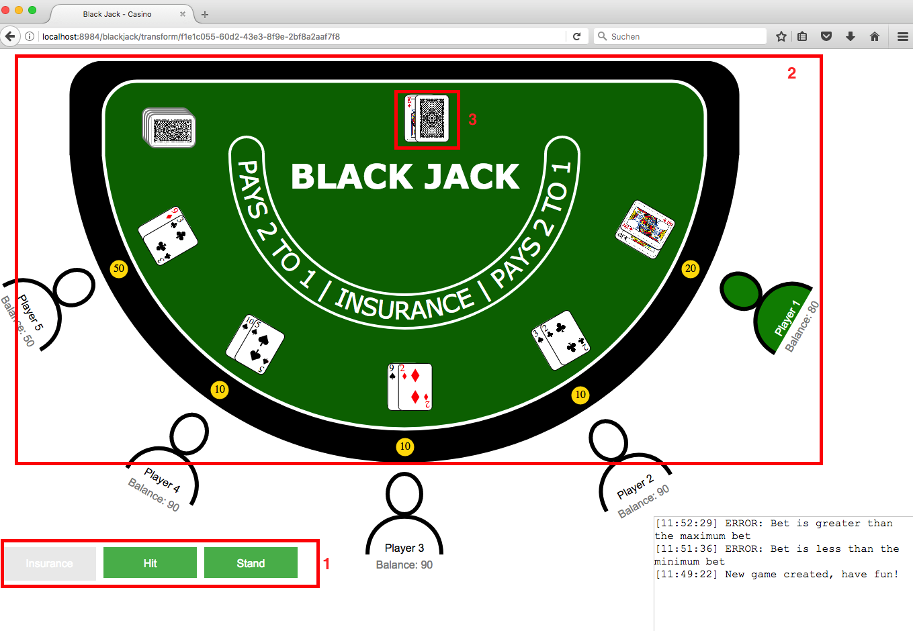
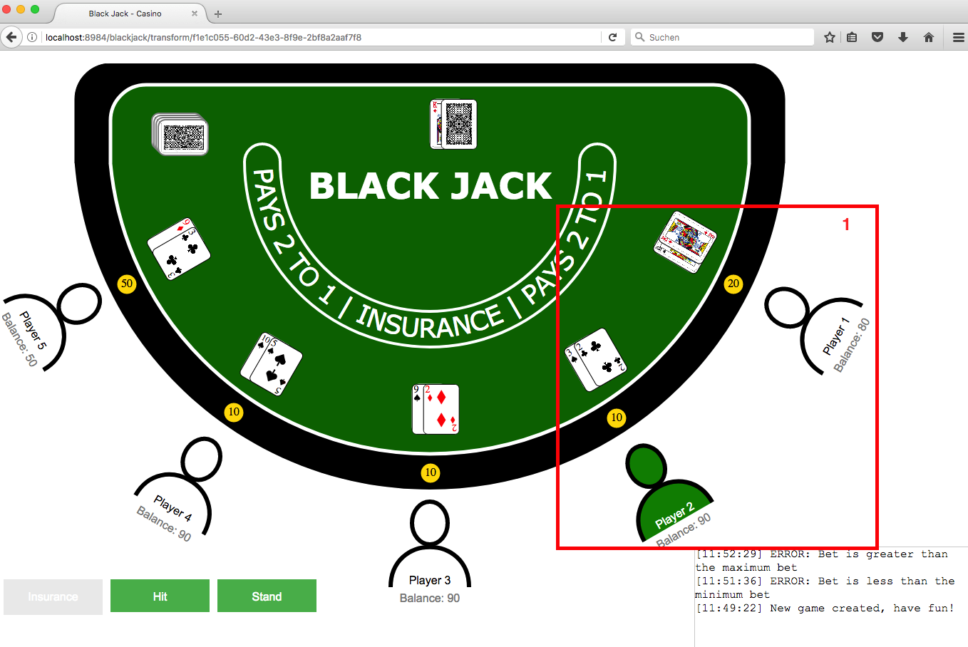
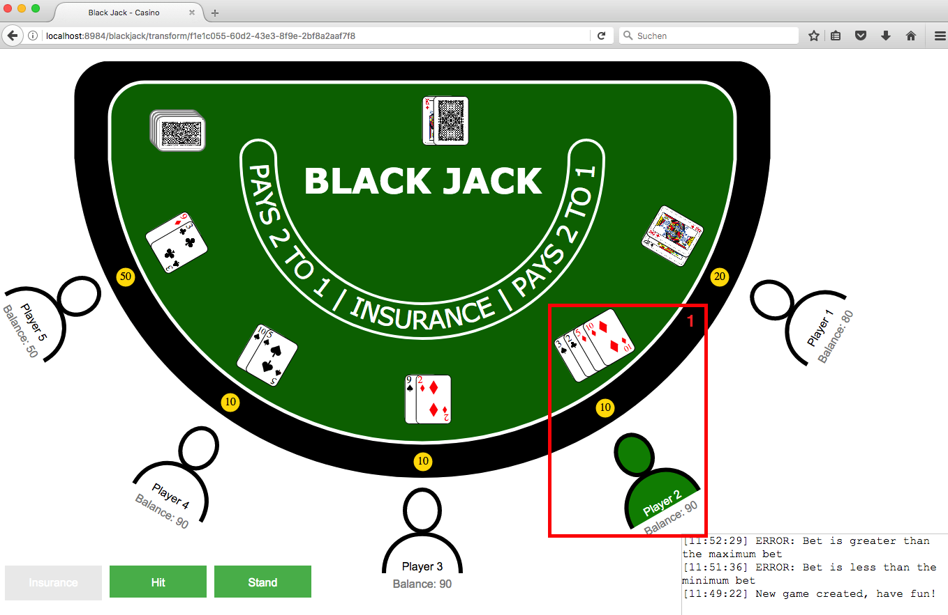
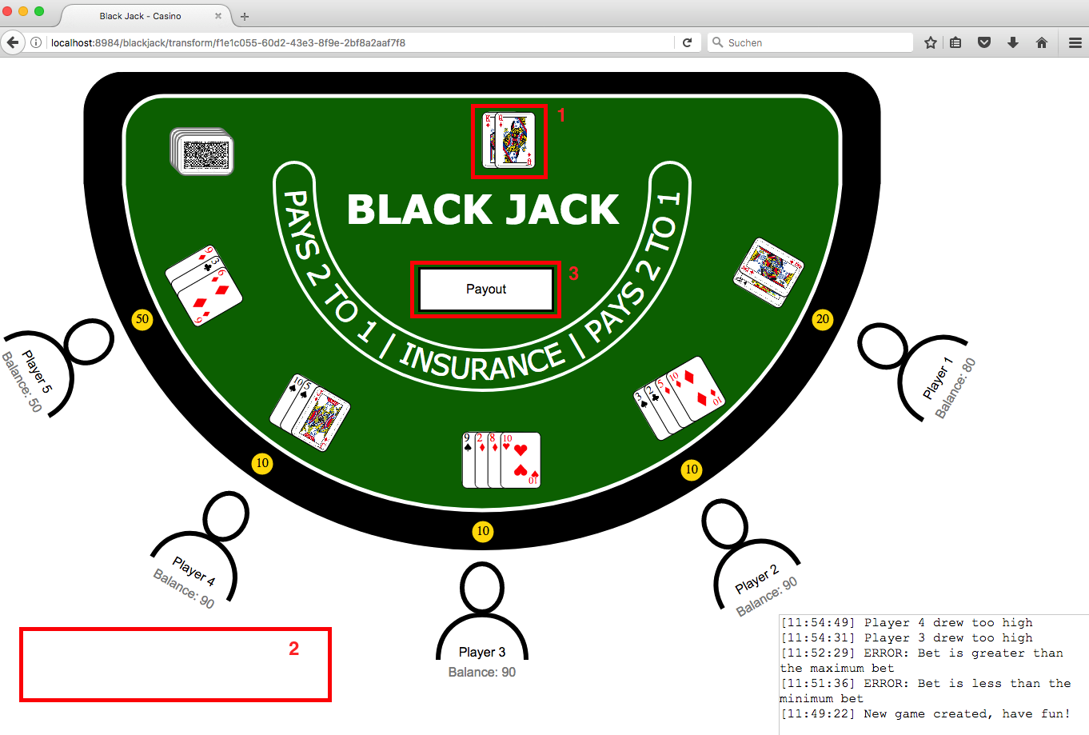
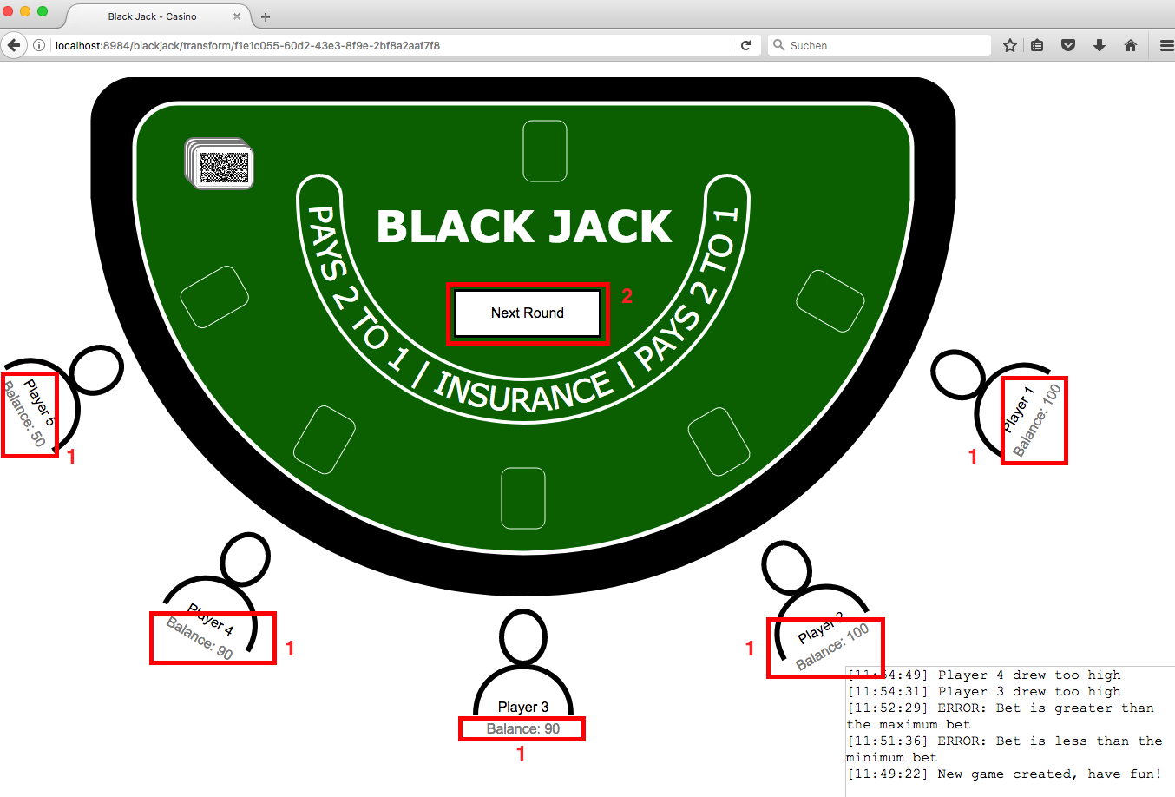
To 8. Demo

